Slide 1

GSoC – GreenMetaData Project
Rosie Schiffmann
10/03/26

Slide 2

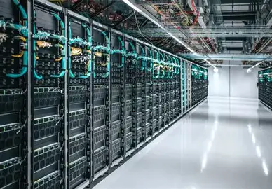
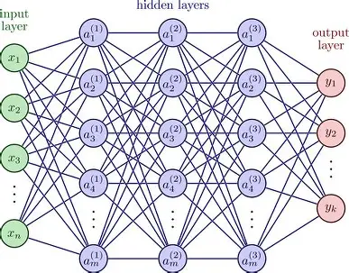

Green Computing… Why?
In research, computational cost is often sacrificed at the hands of statistical significance
High performance computing and data centres emit ~100 megatons of CO2e per year
(Lannelongue et al. 2021)
Typical carbon cost of training a large transformer with neural architecture search is ~5 cars' lifetimes worth of carbon
(Strubell et al. 2019)

Slide 3
GreenMetaData
GreenMetaData establishes a standardised system for reporting software emissions, aiding a shift in academic spaces toward greener attitudes and practices…
Benchmarking carbon emissions of software becomes standard
Researchers become conscious of their environmental impact
Carbon costs become integrated into research planning and budgeting

Slide 4
Topics of Interest: Immediate Impacts
Verifiable, Tamper-Proof Audits
Git version control locking
Digital fingerprint/hash
Preventing greenwashing and develop trust within the green research space
Computer readable (to avoid tampering and be consistent) alongside user friendly interface with human readable results for presentations.
Computer and Human Readable Outputs
Computer readable to promote consistent auditing, with easy integration across other software tools
Human readable results for non-expert accessibility and transparency with users
Energy Hotspot Flagging
To focus future developments of projects on aspect that provide the maximum reduction of carbon costs
Provide data on specific hardware energy consumption for researchers to make informed decisions on their hardware based on the requirements of their software.

Slide 5
Topics of Interest: Contributions to the future
Green Hardware Ranking System
Tracking the performance per watt and incorporating into the GreenMetaData file format
Include hardware manufacturing energy costs
Provide a green-guide for buying new hardware
Incentive for hardware suppliers to minimise their manufacturing and operational carbon costs
Spatially and Temporally Carbon-Aware Computing
Locate and use HPC facilities in low carbon intensity regions via cloud computing
Pause computation in periods of high carbon intensity
Include a metric of carbon-awareness in the GreenMetaData file format
Highlight where researchers have made sustainable decisions for time and place of their computation

Slide 6
Part 2: Hands-On Exercise
CodeCarbon was used to track the energy consumption and emissions of a Monte Carlo neutron transport simulation.
The resulting metrics were stored as a GreenMetaData .yml file, including the embodied carbon cost of the laptop (Lenovo ThinkPad T14 Gen 3 AMD)

Slide 7


Initial Tracking Results
Simulation was running sequentially with a maximum of 1 thread active at any time. This resulted in:
Low CPU utilisation (~6%)
Low CPU power draw (~1W)
Total emissions: 0.95 gCO2e
Reducing environmental impact via green software patterns:
Optimising CPU utilisation
By parallelising the workflow, multiple tasks can run simultaneously

Slide 8
Parallel Computation Results
CPU power draw increased…
But run-times plummeted.
Computational idle time is reduced and energy efficiency is improved.
Total energy consumption is halved!
Initial energy consumption: 0.0040 kWh
Parallelised energy consumption:
0.0019 kWh

Slide 9
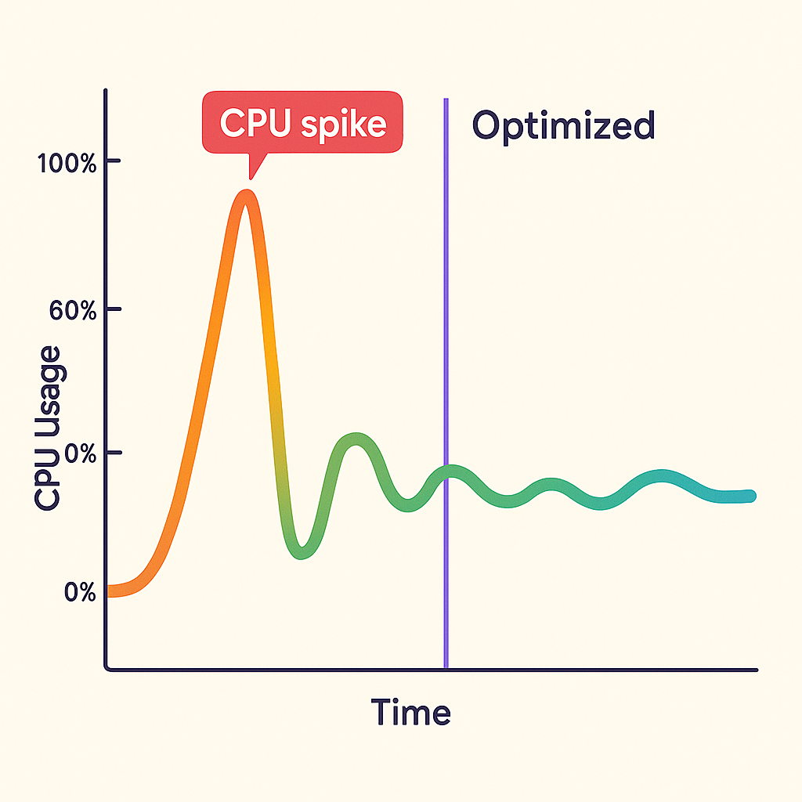
Wider Implications
Increasing CPU utilisation may not always increase energy efficiency.
The key idea is Optimising Average CPU Utilisation.
Optimize average CPU utilization | Green Software Patterns
Goal: Minimise large fluctuations in CPU load, to reduce excessive resources that are under-utilised/ on stand-by.
PHP Tricks That Slash CPU Spikes in Production | by Asian Digital Hub | DevSphere | Medium

